Slide 1
StanLab Guide for Busines Implementation
March 2021
Data

Slide 2
Table of content
“Stanlab Reporting” process, slides 4 and 5
“Stanlab Reporting and Requisition” process, slides 6, 7, 8 and 9
Requisition UI – advice, slides 10, 11 and 13
Requisition UI – example, slide 13
Implementation of invoice information, slide 14
Analysis packages, slide 15
StanLab UI, slides 16, 17, 18, 19 and 20

Slide 3
StanLab* Guide for Business Implementation
This document explains the processes StanLab supports
With logical description of the information in the interfaces and guides to the implementation
It presents the business decisions, to be taken before implementing StanLab
This is not the comprehensive description of methods and interface in StanLab, for more information look here:
API documentation: https://stanlab-api.udv.miljoeportal.dk/openapi/
Technical specification: https://github.com/danmarksmiljoeportal/stanlab/wiki/Stanlab-API
*)StanLab is the name of the system. StanLab2.x is the name of the project that has delivered the requisition process to analysis reporting, thus enhanced the StanLab system considerably.

Slide 4
“StanLab Reporting”
“StanLab Reporting” is the original StanLab interfaces, it consist of two sets of transactions:
Create sample – Creates a sample, where analyses results are stored. The purpose is to create sample with relevant sample information in requesters endpoint and receive a ”SampleID” for the analysis results
Submit Laboratory Test – Submits analysis results to the “SampleID” received from Create Sample
The above process can be used,for instance if the requisition process is a manual process or if the sample taker is the laboratory.

Slide 5
”StanLab Reporting”
Requester
Laboratory
Create Sample
Create Sample
StanLab
Returns SampleID
Returns SampleID
Submit Laboratory
Test
Submit Laboratory
Test

Slide 6
“StanLab Reporting and Requisition”
The “StanLab Requisition” was introduced with 2.x and consists of the following high level transactions
Submit Contract – Creates the laboratory offerings in StanLab for the Requester to chose from when requesting analysis (Submit Requisition)
Submit Requisition – Submits the request for analyses to be performed, along with Sample ID
Submit Laboratory Test – Submits analysis results to the “SampleID” received from Submit Requisition (“StanLab Reporting”)

Slide 7
“StanLab Reporting and Requisition” – in more detail 1/2
Reporting and Requisition – in more detail
Submit Contract – Creates the laboratory offerings in StanLab for the Requester to chose from when creating requisition, Laboratory Contract contains:
Analysis packages agreed upon between Laboratory and Requester
Billing accounts, if Requester has several possible payers registered in Laboratory ERP system.
Alternative delivery terms, if Laboratory can deliver with several different priorities
GraphQL* queries to StanLab, to populate fields in Requesters implementation of requisition user interface. Specific to individual user interface:
Laboratories. (Example: Fetch laboratories to chose from with Analysis packages for the current matrix,)
Analysis packages (Example: Fetch analyses packages to chose from for chosen Laboratory and matrix)
Billing Accounts (Example: Fetch Billing Accounts for chosen Laboratory
Delivery terms: (Example: Fetch valid Delivery terms for chosen analysis packages
*) The GraphQL queries supports individual implementation of Stanlab Requisition in the requesters UI. Requester can use these queries to make a UI that is fully adapted to the Requesters process.

Slide 8
“StanLab Reporting and Requisition” – in more detail 2/2
Reporting and Requisition – in more detail
Submit Requisition, this interface contains
Laboratory, Analysis Packages, Billingaccounts, Delivery terms. Any Requisition can have several analysis packages
SampleID for the result to be stored upon
Container references. Requesters UI may contain barcode scanner to populate these fields
Requisition remarks (optional), Contact information sampler (optional), Contact information (optional)
Various other optional fields *
Get Sample – StanLab performs call back to Requester to verify validity of SampleID
Pull Requisition – Laboratory asynchronous pulls the Requisition from StanLab and adds Laboratory Reference to requisition in Confirm Requisition
Submit Laboratory Test – Submits analysis results to the “SampleID” received from Submit Requisition.
*) The business analysis of the Requester determines which optional fields should be used in the implementation.

Slide 9
”StanLab Reporting and Requisition”
Requester
Laboratory
Get contract info
Graph QL queries
Submit Contracts
Submit Requisition
Pull Requisition
Get Sample
StanLab
Confirm Requisition
Submit Laboratory
Results
Submit Laboratory
Results

Slide 10
Requisition UI – advice 1/3
Some advice, for the Requester for building own processes and UI:
Decide your Requisition Process
Do you want your UI to produce multiple requisitions for multiple Sample ID´s in one go – or is it one requisition at a time. If you produce multiple samples, you might find it useful to develop a UI that can “shot them all” in one go.
Tip: Increase useability and minimize errors by validating for unique container reference, StanLab does not validate container reference uniqueness, across requisitions. If container references are not unique, the laboratory will not be able to tell the difference between your samples.
Decide on your order of data entry
You can decide your UI freely. E.g. you can start by choosing laboratory or you can start by choosing analysis packages..
Tip: Increase useability. If there is only one hit on the GraphQL query, autofill and make fields read only or leave them out of the UI.

Slide 11
Requisition UI – advice 2/3
Some advice, for the Requester for building own processes and UI:
Data entry fields needed to process the analysis:
Container reference mandatory – implement barcode scanner in UI.
Package reference mandatory – contains chosen analysis package(s), if only one available on contract, autofill
Sample taker – autofill with users name, phone, email, if possible
Contact person – autofill from last requisition from same location
Sample remarks – omit if not to be used
Storage time – omit if not useful, if “null” storage time will be according to contract. If rarely needed use sample remarks instead.
Data entry fields needed process invoice:
This is described in the slide “Laboratory implementation of invoice information”

Slide 12
Requisition UI – advice 3/3
Some advice, for the Requester for building own processes and UI:
Make it possible to view which requisition you have sent. (GraphQL query)
When you have sent you requisitions, you could make your UI, so you can see which requisitions you have sent.
Laboratory Reference should be visible in this UI, when the requisition has been pulled by the Laboratory
Also the Laboratory Reference field will come in handy in any dialogue with the Laboratory
You can choose to create a hyperlink from the requisition to the StanLab UI, if you want the user to have quick access to see the status of requisitions sent
Below you can se an screenshot showing the sent requisition, with a hyperlink to StanLab UI in Laboratory reference field.

Slide 13
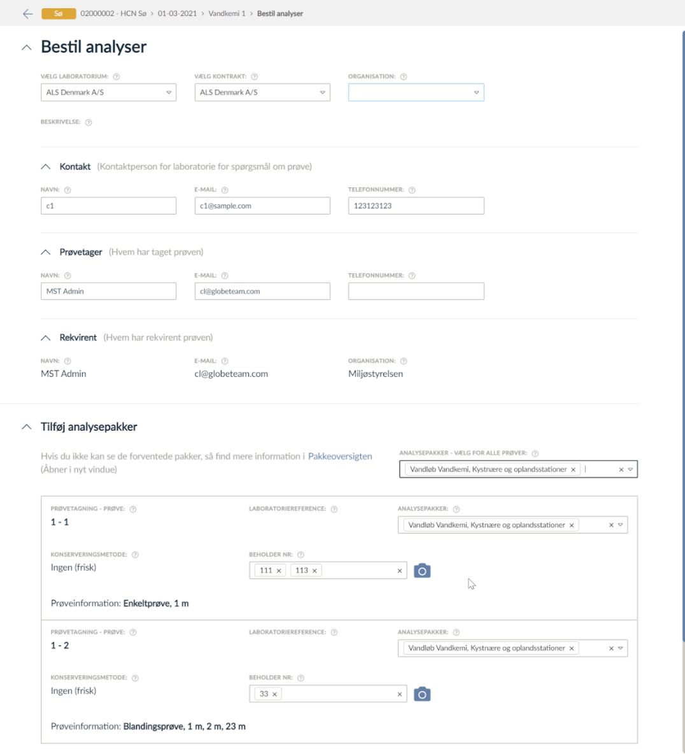
Requisition UI – example
Example of Requisition UI
The fields in this section is from an earlier version of the interface, the fields could be Laboratory and Billing Accounts. The Requester has 7 different units ordering analyses, this is 7 billing accounts.
In this UI you can generate multiple requisitions in one go and the UI also makes it possible to add the same packages to all the requisitions in one go. This example has two samples.
The UI has implemented a barcode scanner JavaScript for the package references.
Sample remarks (not visible below the samples) are added to all requisitions, not possible to add remarks to individual requisitions, done for simplicity

Slide 14
Implementation of invoice information
StanLab provides three different methods to parse invoice information to laboratory, any of which can be used
Billing accounts. This a list of “accounts” created in Laboratory ERP system. Requester asks laboratory to create billing account, for different fixed sets of information.
GetSamle. This returns sample information. Requester asks laboratory to parse information from Get Sample to invoice.
From Submit Requisition:
OrderReference, this is either manually or automatically entered. This field is mapped to 'Invoice.OrderReference.CustomerReference’ in EAN/OIOUBL. *)
”OrderlineReference”, this is either manually or automatically entered. This field is mapped to 'Invoice.InvoiceLine.OrderLineReferenc” in EAN/OIOUBL.
“Person reference” this is either manually or automatically entered. This field is mapped to 'Invoice.InvoiceLine.PersonReferenc” in EAN/OIOUBL.
Any other field in SubmitRequisition
The business analysis performed prior to implementation will determine which of the above methods are used.
*) Laboratories usually invoice several requisitions at at time, this should be noticed when using Orderreference.

Slide 15
Analysis Packages
Analysis Packages in Submit Contract contains a list of analysis packages agreed upon between requester and laboratory.
Analyse Package
Name, requesters name of package, userfriendly name, visible in Requisition UI.
Reference, laboratory name of package, internal name
Matrix, the analysis matrix the analysis is performed on. Stancode 1183
Etc.
List of analyses
Parameter Stancode 1008
Unit Stancode 1009
Method Stancode
Etc.
…
Name/Matrix is considered unique in StanLab. A contract cannot contain two analysis packages with identical Name/Matrix.
Full description available here: https://stanlab-api.udv.miljoeportal.dk/openapi/#operation/SubmitContract

Slide 16
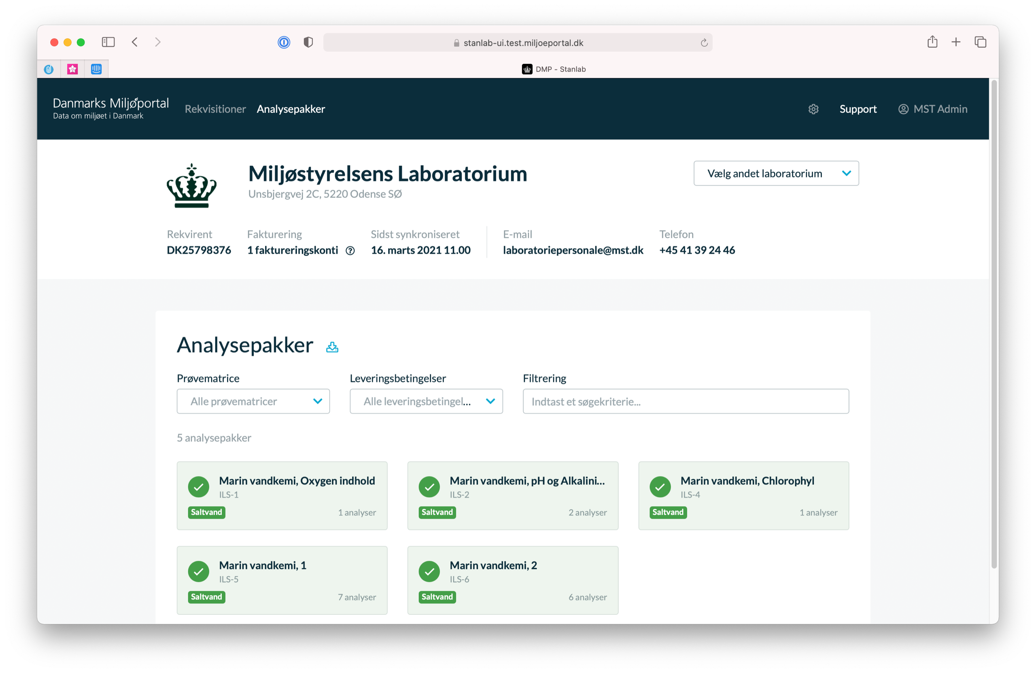
StanLab UI View Contract
Both requester and laboratory use the StanLab UI, both can only see only their own information.
Billing accounts
Delivery terms
Packages

Slide 17
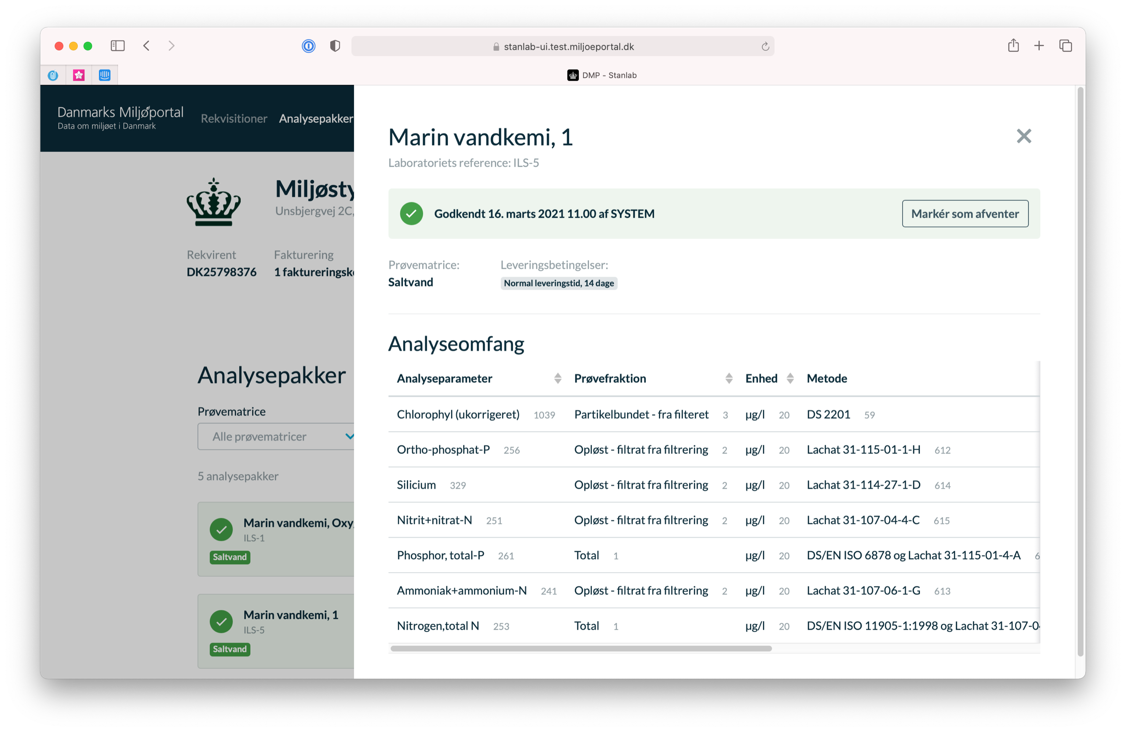
StanLab UI View Analysis Package
Requester can chose to either manually approve new/changed packages or have StanLab to auto approve changes to analysis packages.
Package approved on/off
Name
Matrix
Parameter

Slide 18
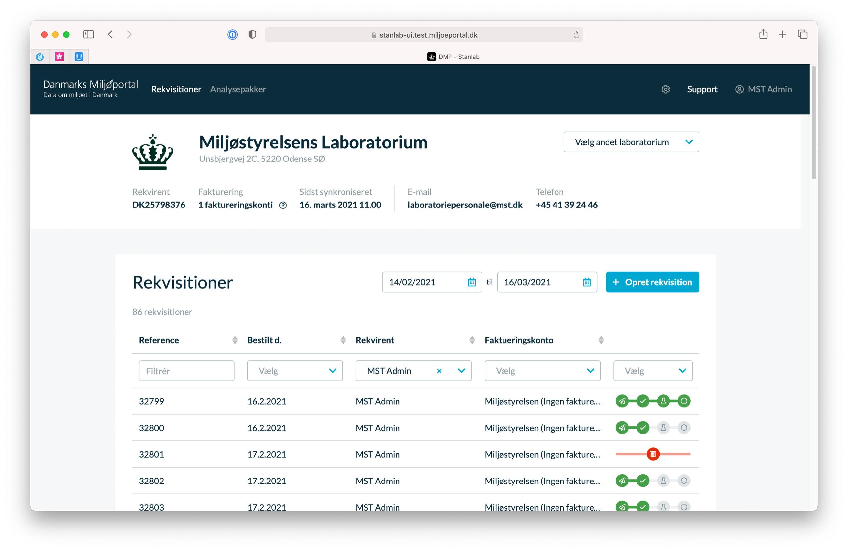
StanLab UI View List of Requisitions
StanLab displays a list of requisitions for each laboratory, if user is requester. If user is laboratory the list shows requisitions for each requestor.
Change laboratory/change requisition party
Requisition status
User
Laboratory reference

Slide 19
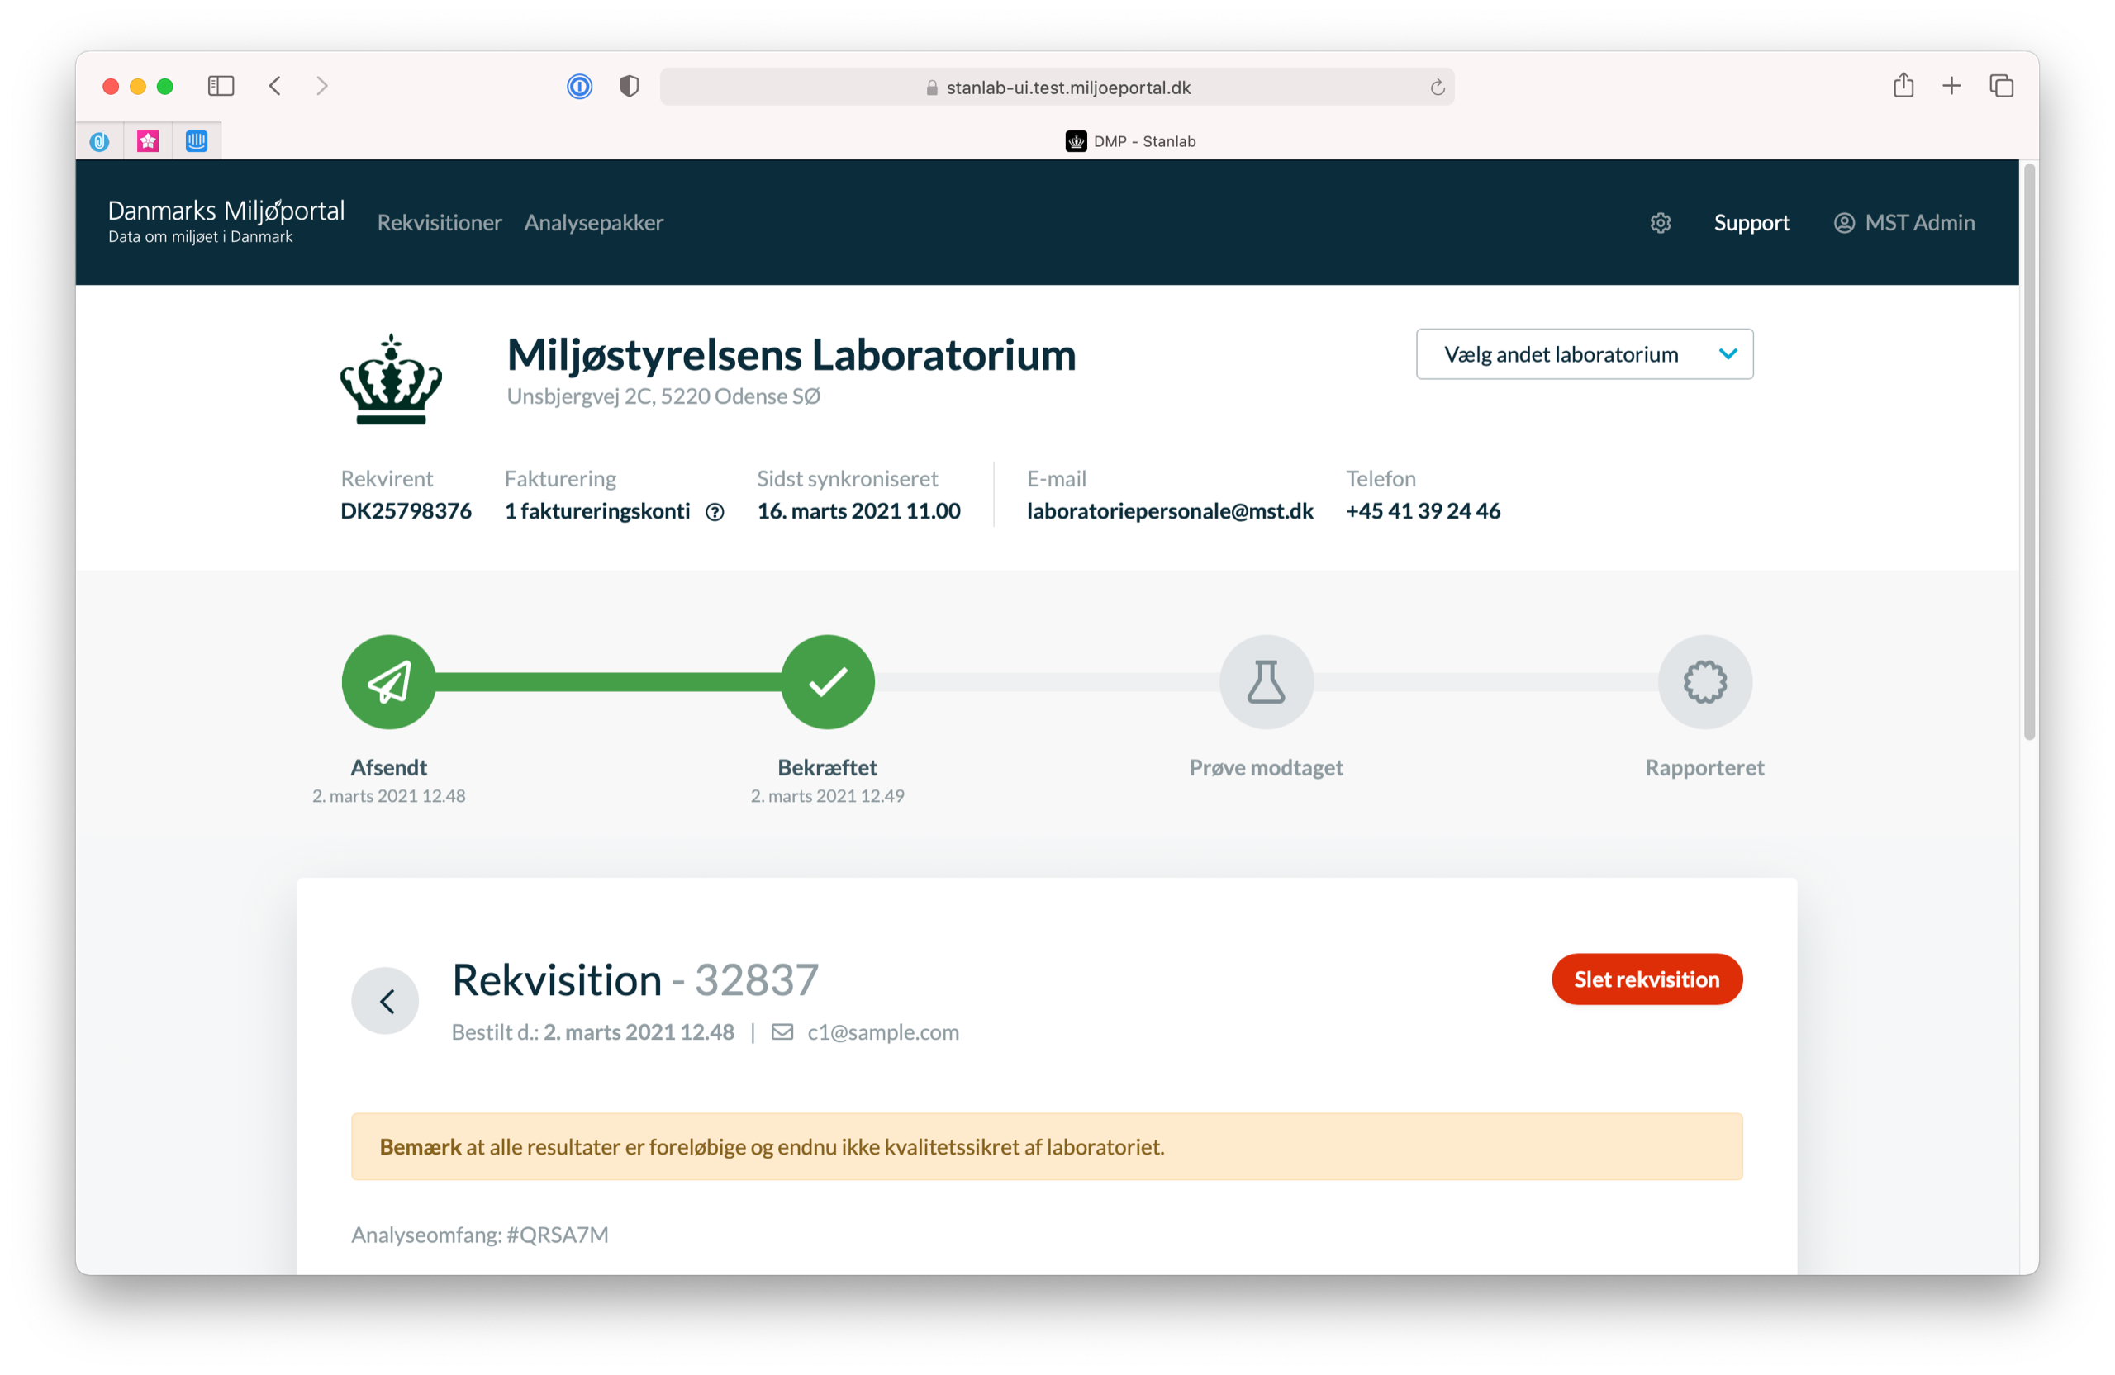
StanLab UI View Requisition
Requisitions can be deleted, by requestor, if not not pulled by laboratory. Once pulled only laboratory can delete requisition.
Delete requisition

Slide 20
Support and questions
If you have any questions to the StanLab solution please contact Danmarks Miljøportal
https://miljoeportal.dk/
Danmarks Miljøportal
Nyropsgade 30,
1780 København V
+45 31 50 15 70

